Slide 1
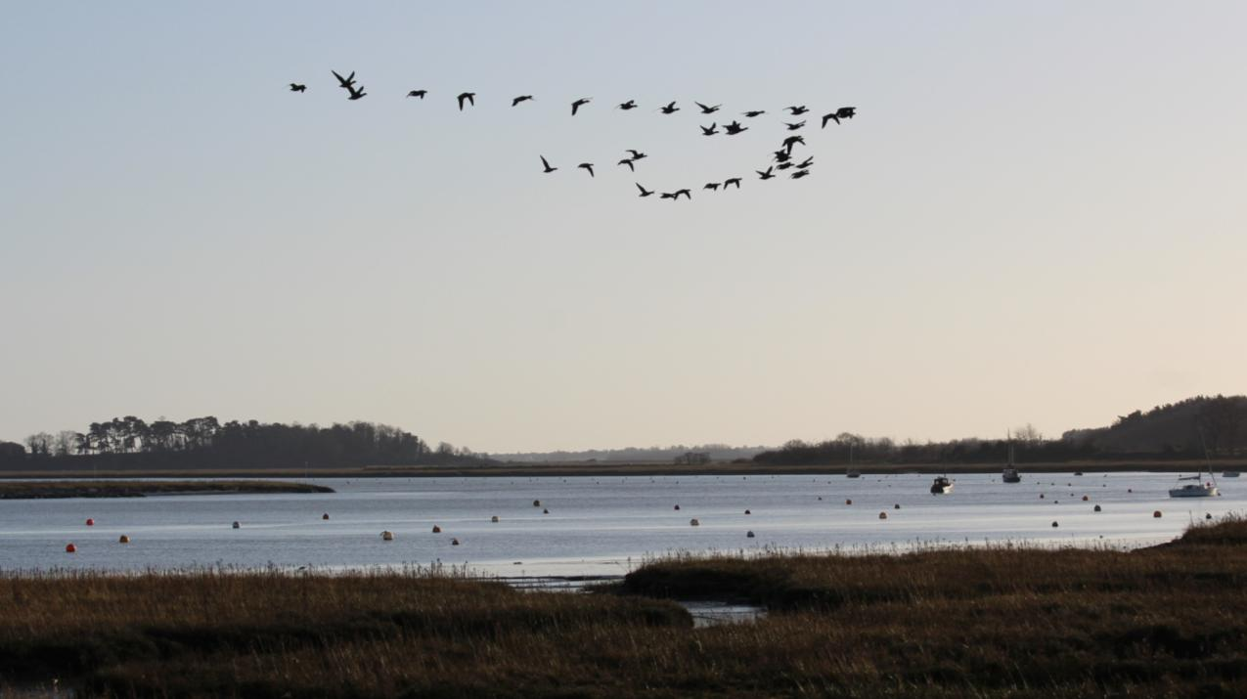
Parish Council Report for the
Waldringfield Annual Parish Meeting
April 2023

Slide 2
Members of the Parish Council (up to 4th May):
Ian Kay | Chairman/Parish Liaison/WALGA/Emergency Planning/Notice Board - Waldringfield Heath
Janet Elliot | Vice Chair/Church Field Trust/Planning/SALC
Colin Archer | Tennis Court/Playing Field
Serena Gold | Footpaths/Fairway Committee/Church Field Trust/Planning/Beach
Colin Reid | Playing Field/Fairway Committee/SID Coordinator
Sue Quick | Beach/Climate and Biodiversity Coordinator/Emergency Planning Liaison
Nigel Shore | Village Hall/Website
Cathy Couchman | Village Sign and Benches/Felixstowe Partnership liaison/Safeguarding Lead
Jennifer Shone-Tribley | Clerk & RFO/Website/Safeguarding Deputy/Notice Board – Cliff Rd
Chris Lyon and Paul Beaumont resigned from the Parish Council in June ‘22 and January ‘23 respectively.
Colin Archer will not be standing for re-election in May.
Many thanks to Chris, Paul and Colin for their services.
Parish Council Appointees:
Christine Fisher-Kay | Tree Warden
John Smith | Flood warden
Jon Wilkins | Deputy Flood Warden
Tony Lyon | Deputy Flood Warden/Defibrillator Liaison

Slide 3
Parish Council Election (4th May, 7am to 10pm)
The number of Councillors to be elected is 9. Since there are only 7 candidates the election will be uncontested and all the candidates will be returned.
District Council Election
The number of District Councillors to be elected is 2.

Slide 4
Council Meetings
Council meetings are held on the 2nd Tuesday of the month at 7.30pm in the Village Hall. Dates for 2023 are:
16 May 2023 (plus Annual Parish Council Meeting)‏
13 June 2023
11 July 2023
08 August 2023
12 September 2023
10 October 2023
14 November 2023
12 December 2023
All Parish Council meetings are open to the public and there is an opportunity at these meetings for residents to put information to the Council and ask questions.
Agendas are posted on the two noticeboards and Waldringfielders three working day in advance of the meeting.

Slide 5
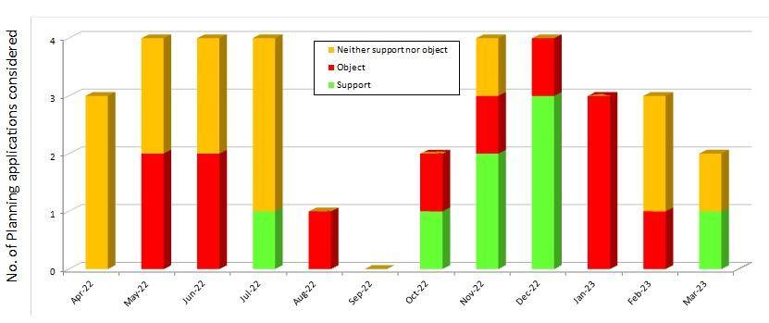
Council Activities
The Council has dealt with 34 planning applications since April 2022:
8 were supported by the PC
12 were opposed by the PC
14 were neither supported nor opposed by the PC
Most of the work is done by the Planning Group, Janet Elliot and Serena Gold, but decisions are taken by the full Council.

Slide 6
Council Activities
The Council provides funds for:
The village hall (maintenance)
Parochial Church (grounds maintenance)
Church Field (grounds maintenance)
Waldringfield Wildlife Group (verges project)
Tennis Club (grounds maintenance)
Parish Councillors have represented WPC at many meetings:
SALC
Fairway Committee
Church Field Trust
WALGA
etc....
Maintenance of the playing field and its equipment
And much more...

Slide 7
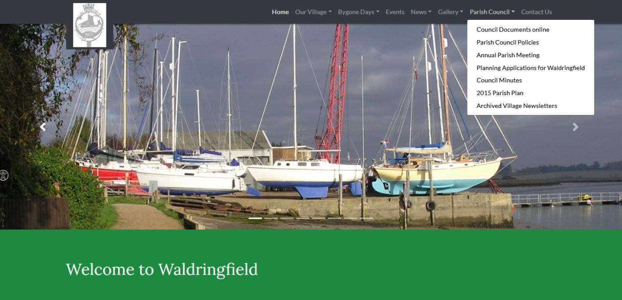
Website
Meeting dates and other information* about the Council can be found by following the ‘Parish Council’ link at the Waldringfield web site at:
http://waldringfield.onesuffolk.net/
*Agendas, minutes, planning applications, Council policies, news, documents, village newsletter, etc.

Slide 8
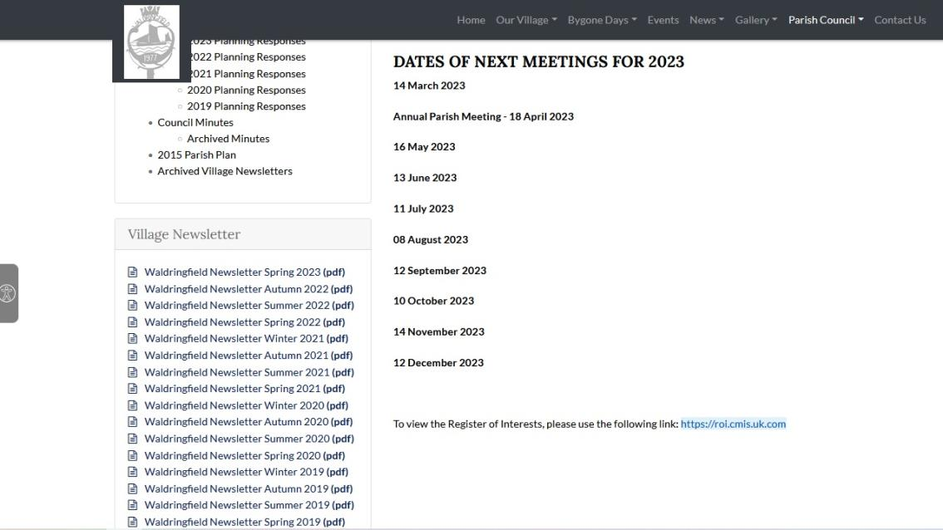
Parish Newsletter
4 Parish Newsletters are produced each year, on 1st March, 1st June, 1st September and 1st December
Over 250 copies are delivered to every house in the Parish by 14 volunteers (thank you!!)
The online version can be found on the Parish Council web site:

Slide 9
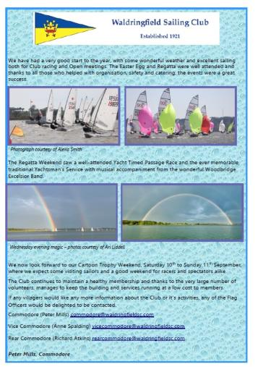
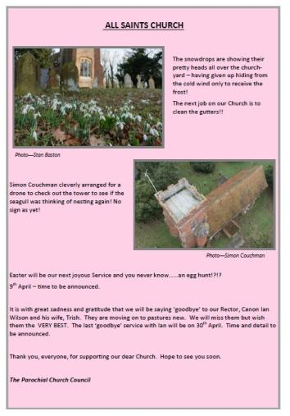
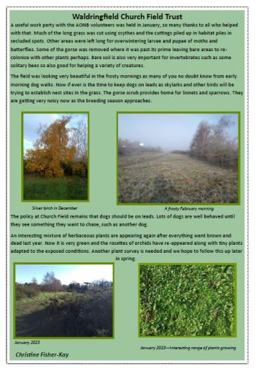
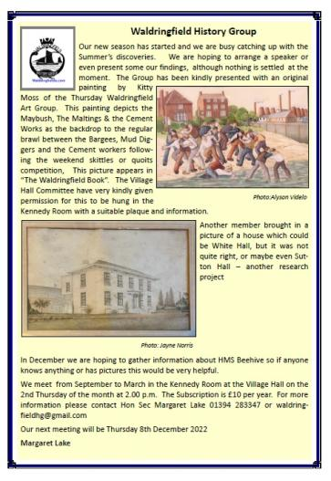
Parish Newsletter
The Clerk, Jennifer Shone-Tribley, organises its production, printing and distribution.
Local businesses can advertise in the newsletter
Non-profit making community groups may promote their activities for free
Copy deadlines are 2 weeks or so ahead of publication

Slide 10
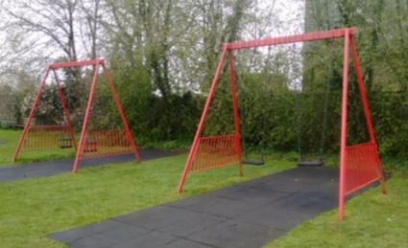
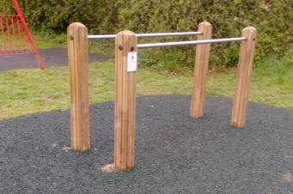
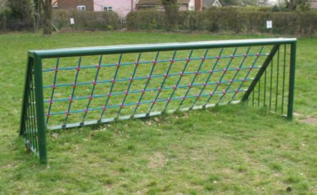
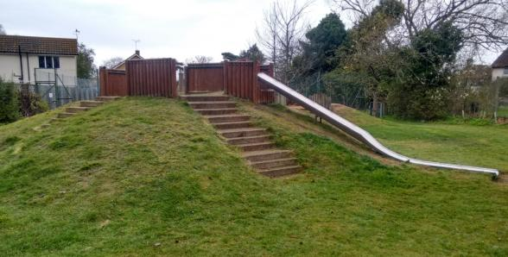
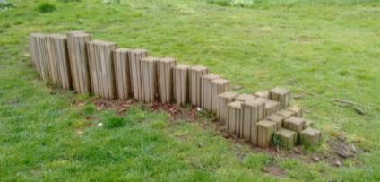
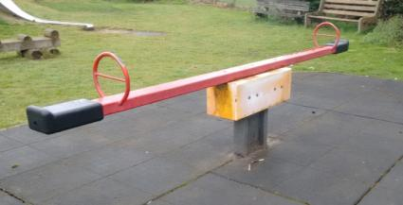
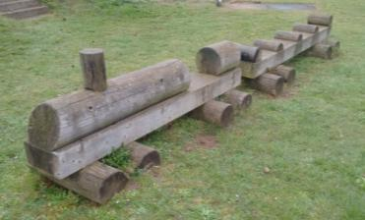
New Playing field equipment
Before last summer the equipment was for younger children. There was little on site for children over 7 years of age and no inclusive equipment.

Slide 11
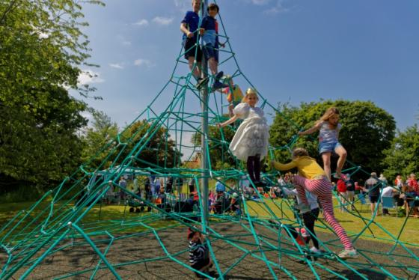
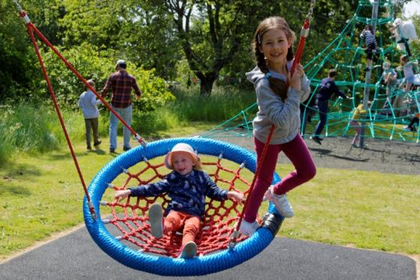
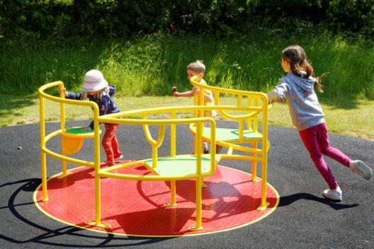
New Playing field equipment
Last summer the PC ordered 3 new items of play equipment....
‘Spacenet’ -
a large climbing challenge
Basket swing –
suitable for children of all ages
Inclusive roundabout - suitable for children with disabilities

Slide 12
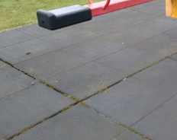
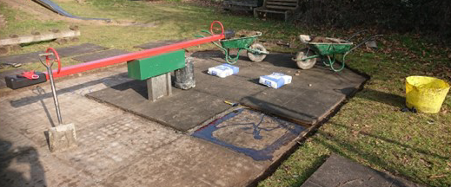
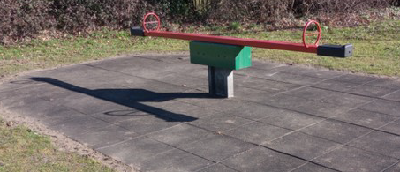
Maintenance Work on Play Equipment
As part of the Parish Council’s ongoing inspections of the play equipment, the safety surface at the base of the seesaw was found to be in need of re-laying, as some of the tiles were coming adrift. The Parish Council engaged the local company, PlayQuip, to fix the problem. ....
Re-laying the tiles
Gaps had appeared between the tiles
The completed work, the concrete perimeter is under a thin layer of earth

Slide 13
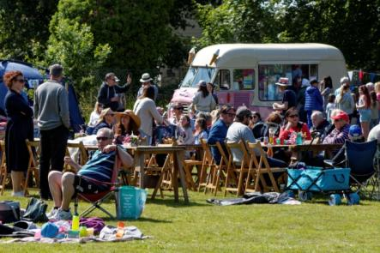
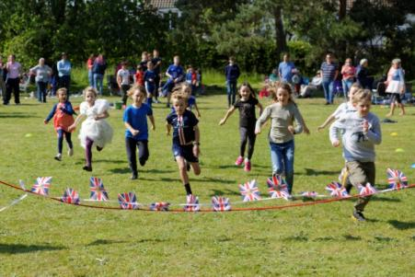
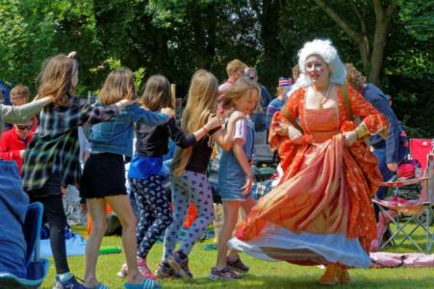
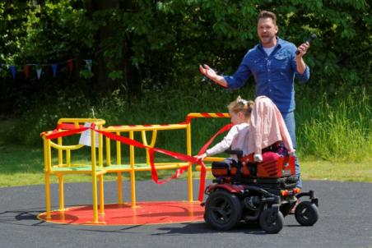
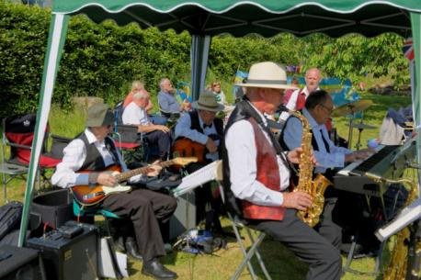
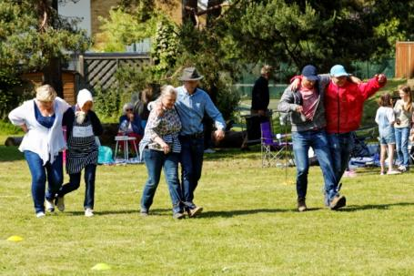
Queen’s Platinum Jubilee Picnic (June 2022)
As part of the Queen’s Platinum Jubilee celebrations, and with the help of volunteers, Waldringfield Parish Council organised an event on the children’s playing field...

Slide 14
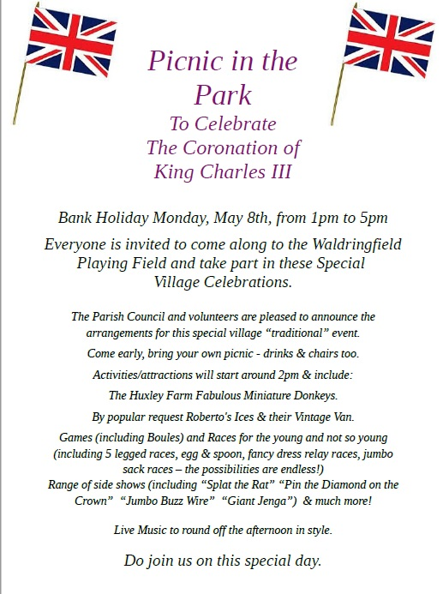
Coronation Picnic...

Slide 15
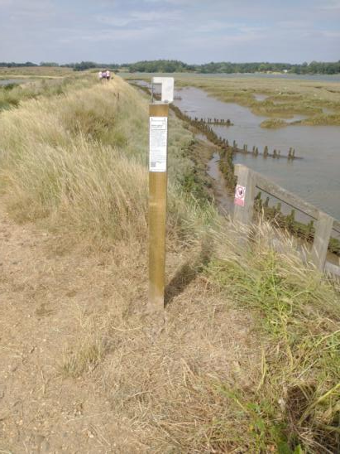
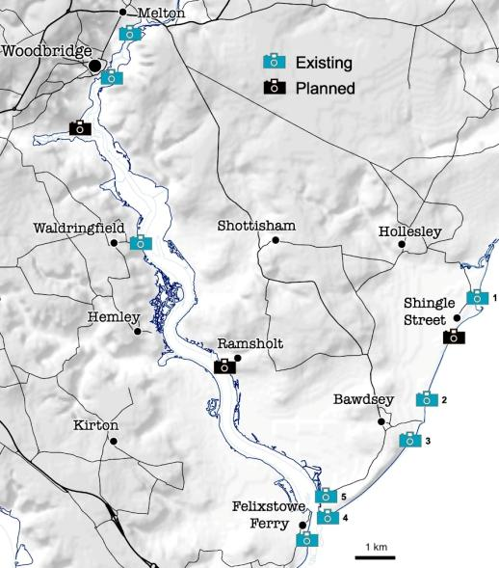
Waldringfield Photo Post
The Waldringfield PhotoPost is part of a wider network of fixed-point photography sites around the Deben estuary and coast, supporting the monitoring and understanding of coastal change.
The Deben PhotoPosts project is a public and community monitoring enterprise involving the Deben Estuary Partnership, Bawdsey Parish Council, and coastal scientist Helene Burningham of UCL
The PhotoPost is located north of Waldringfield on the river wall, with a view over the Deben estuary

Slide 16
Warm Room & Pantry Project
Open every Wednesday afternoon in the Kennedy Room.
The Community Pantry is funded by the East Suffolk District Council "ease the squeeze" initiative. It offers a selection of groceries, free of charge and is accessible Tuesday evenings in addition to Wednesday afternoons.
On February 15th East Suffolk Citizens Advice will be providing a special one-off outreach session.
Many thanks to The Maybush for providing soup and rolls, Councillors Janet Elliot and Cathy Couchman for their hard work in organising these events, and to the 16 volunteers who have helped out at the sessions.

Slide 17
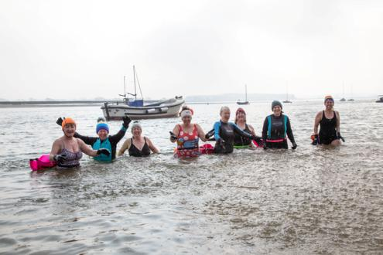
Designated Bathing Water Status
The River Deben at Waldringfield has been granted Designated Bathing Water status. This means the water will be monitored by the Environment Agency, which will take samples during the bathing season between 15th May and 30th September. The agency will then assess whether action is needed to cut pollution levels and will work with communities, farmers and water companies to improve water quality.
The consultation process for the bathing status application revealed 106 bathers used the Waldringfield section.
Waldringfield is only the third inland water site - and the first stretch of tidal estuary in the UK - to receive this bathing water status.
Many thanks to Ruth Leach and Caroline Page of Save the Deben for all their hard work.

Slide 18
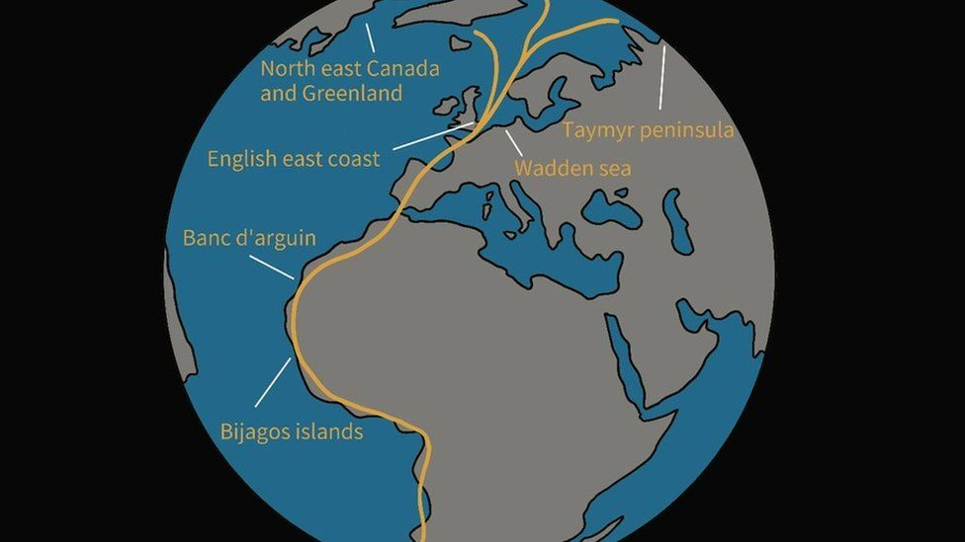
UNESCO World Heritage Status –
East Atlantic Flyway
The East Atlantic Flyway, an area covering some 800 miles, is one of seven sites to be put forward by the UK government to get the status. It is a migratory bird route over western parts of Europe including Yorkshire, Lincolnshire, Norfolk, Suffolk, Essex and Kent, joins the UK’s list in recognition of its vital importance to bird populations and wildlife.

Slide 19
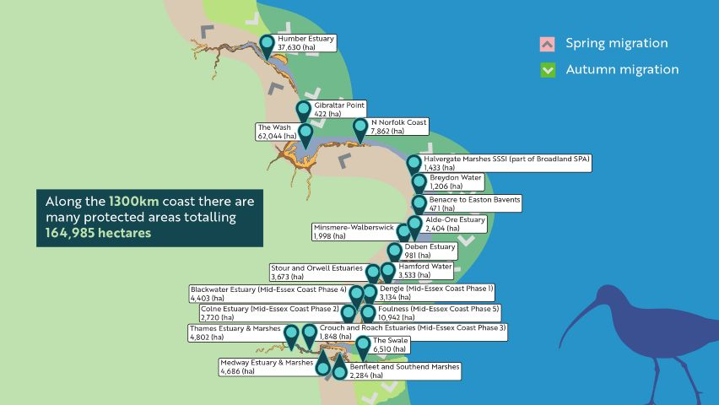
UNESCO World Heritage Status –
East Atlantic Flyway

Slide 20
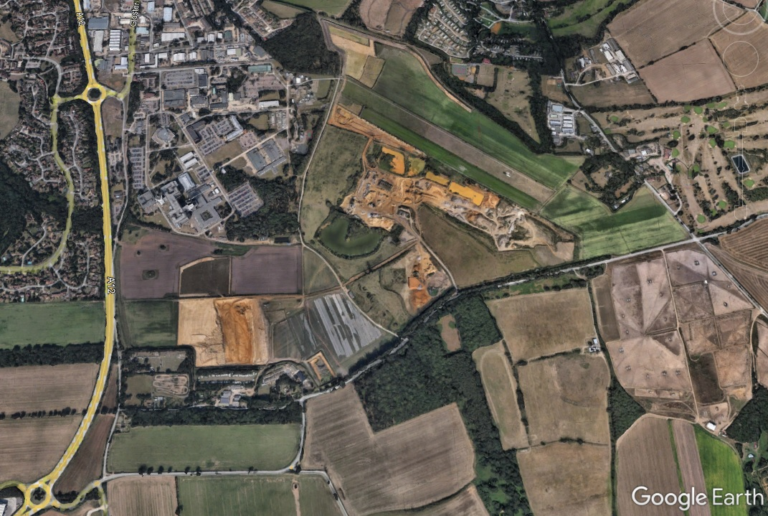
Brightwell Lakes

Slide 21
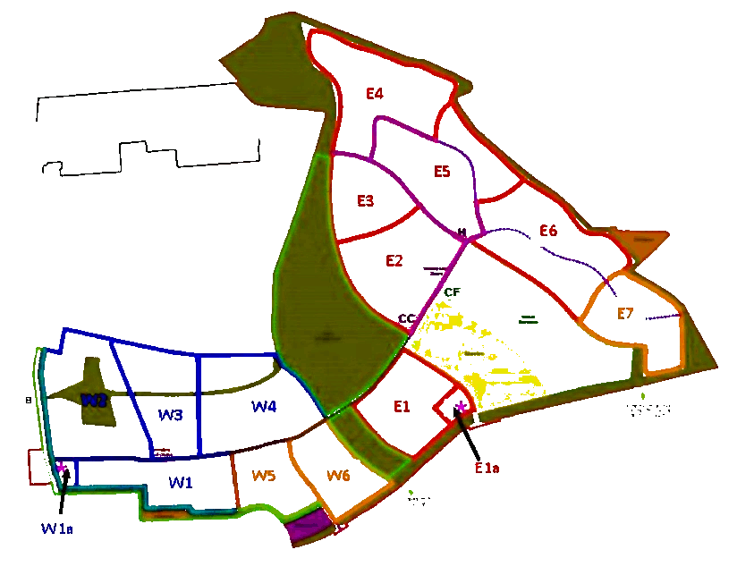
Brightwell Lakes - Phasing

Slide 22
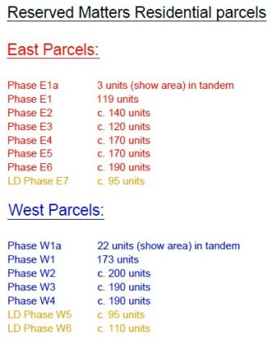
Brightwell Lakes - Phasing
E1
W1

Slide 23
Brightwell Lakes - Phasing
E1
W1

Slide 24
Brightwell Lakes - Phasing
E1
W1
W5
W6

Slide 25
Brightwell Lakes - Phasing
E4
E5
E3
E6
E2
E7
E1
W1
W5
W6

Slide 26
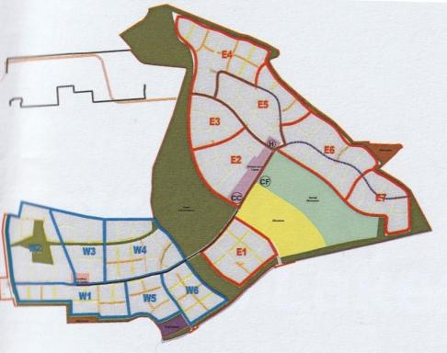
Brightwell Lakes - Phasing

Slide 27
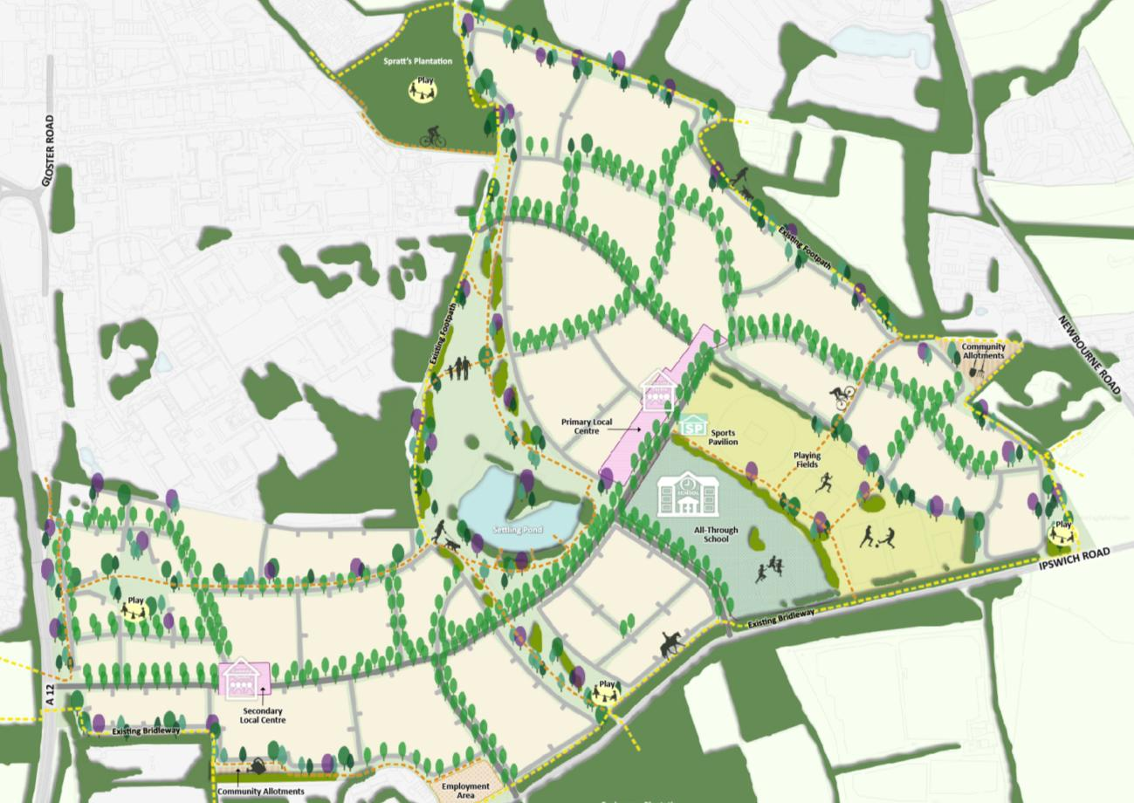
Brightwell Lakes - Facilities
Community Building & Local Centre - Coming in 2032
Central SANG Area - Coming in 2026
Sports pitches - Coming in 2029
Secondary Local Centre - Coming in 2030
Allotments - Coming in 2027
School - Coming in September 2027
Play Area - Coming in 2026

Slide 28
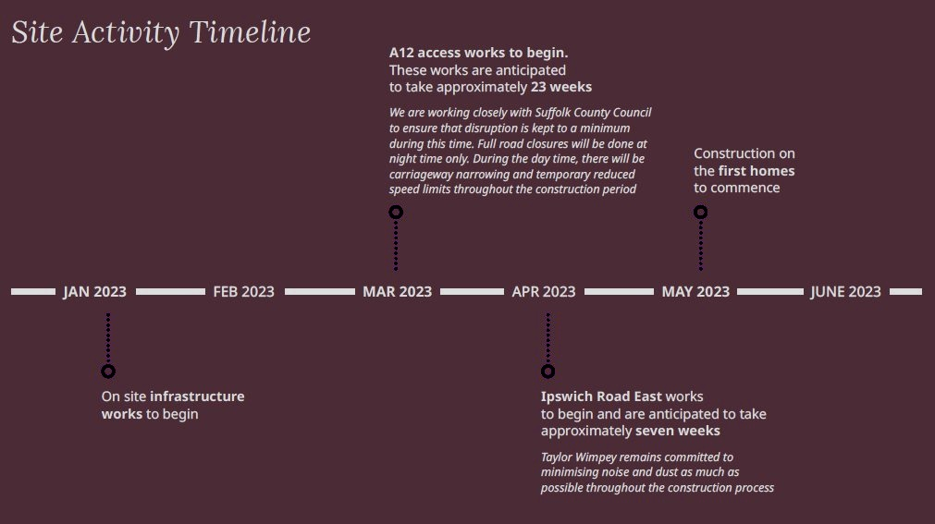
Brightwell Lakes – Timeline (2023)

Slide 29
Question?

