Slide 1
Waldringfield Sailing Club
2024

Slide 2
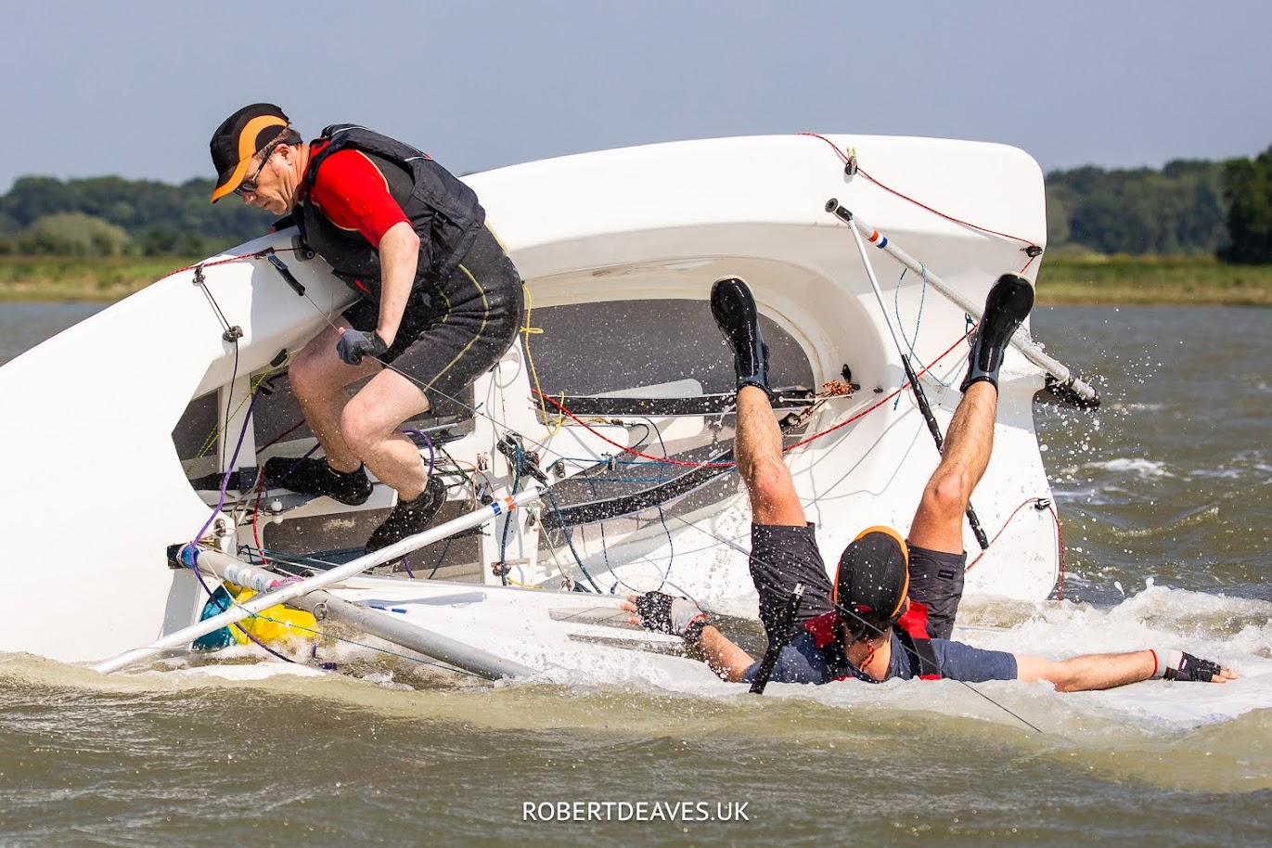
Sailing is fun!
Thrills and spills can happen to anyone…
and other days are a gentle drift…

Slide 3
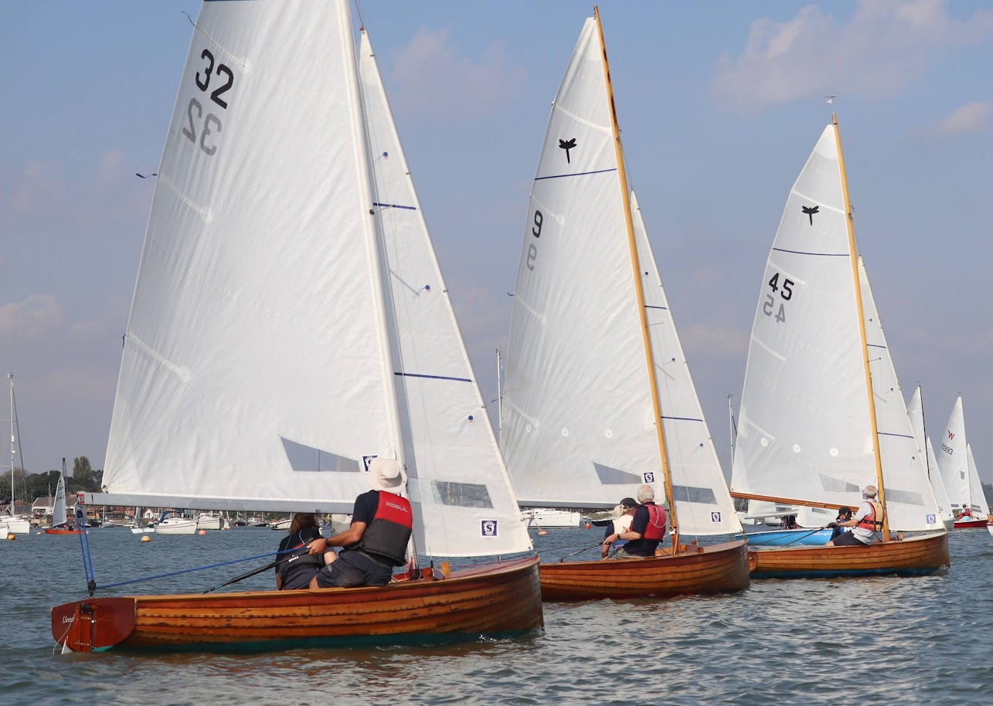
Fleet racing Boats sailing against others in the same class. Our primary activity, visible on Saturdays and Wednesday evenings.

Slide 4
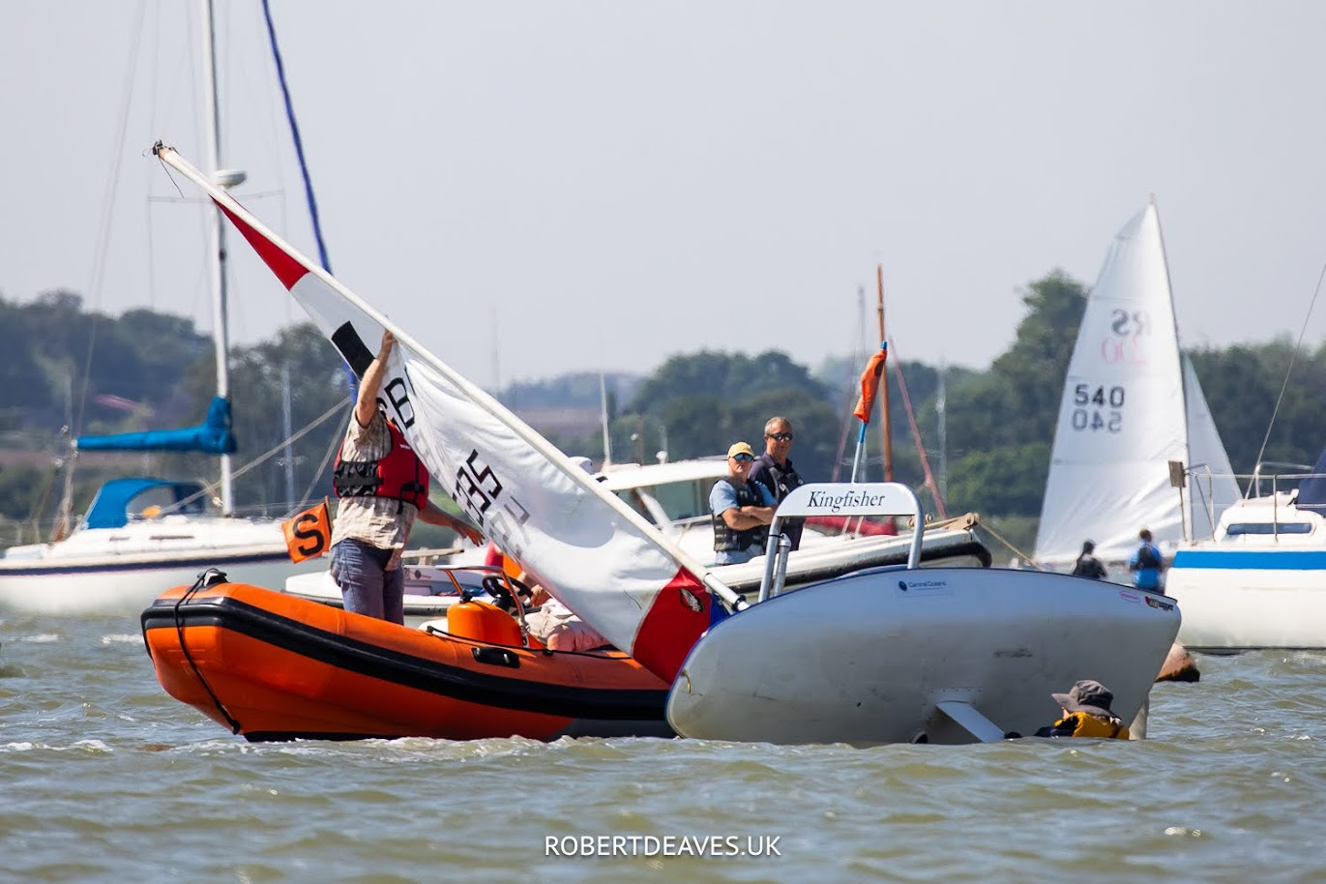
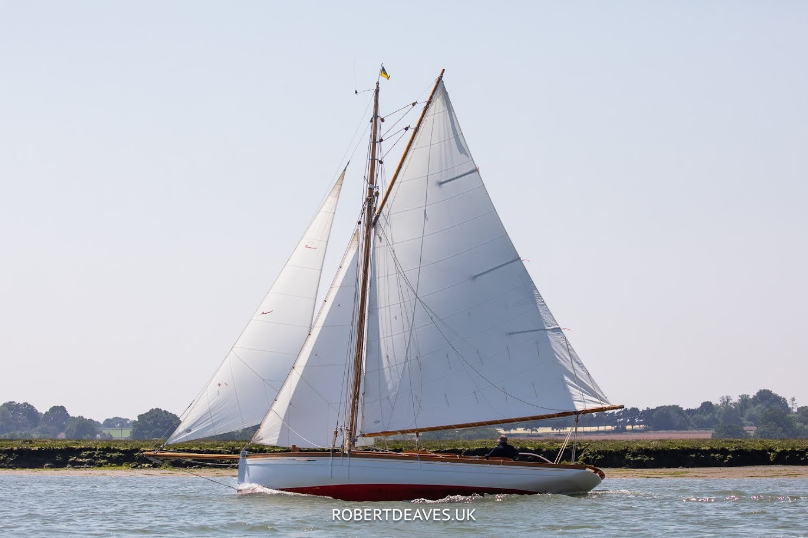
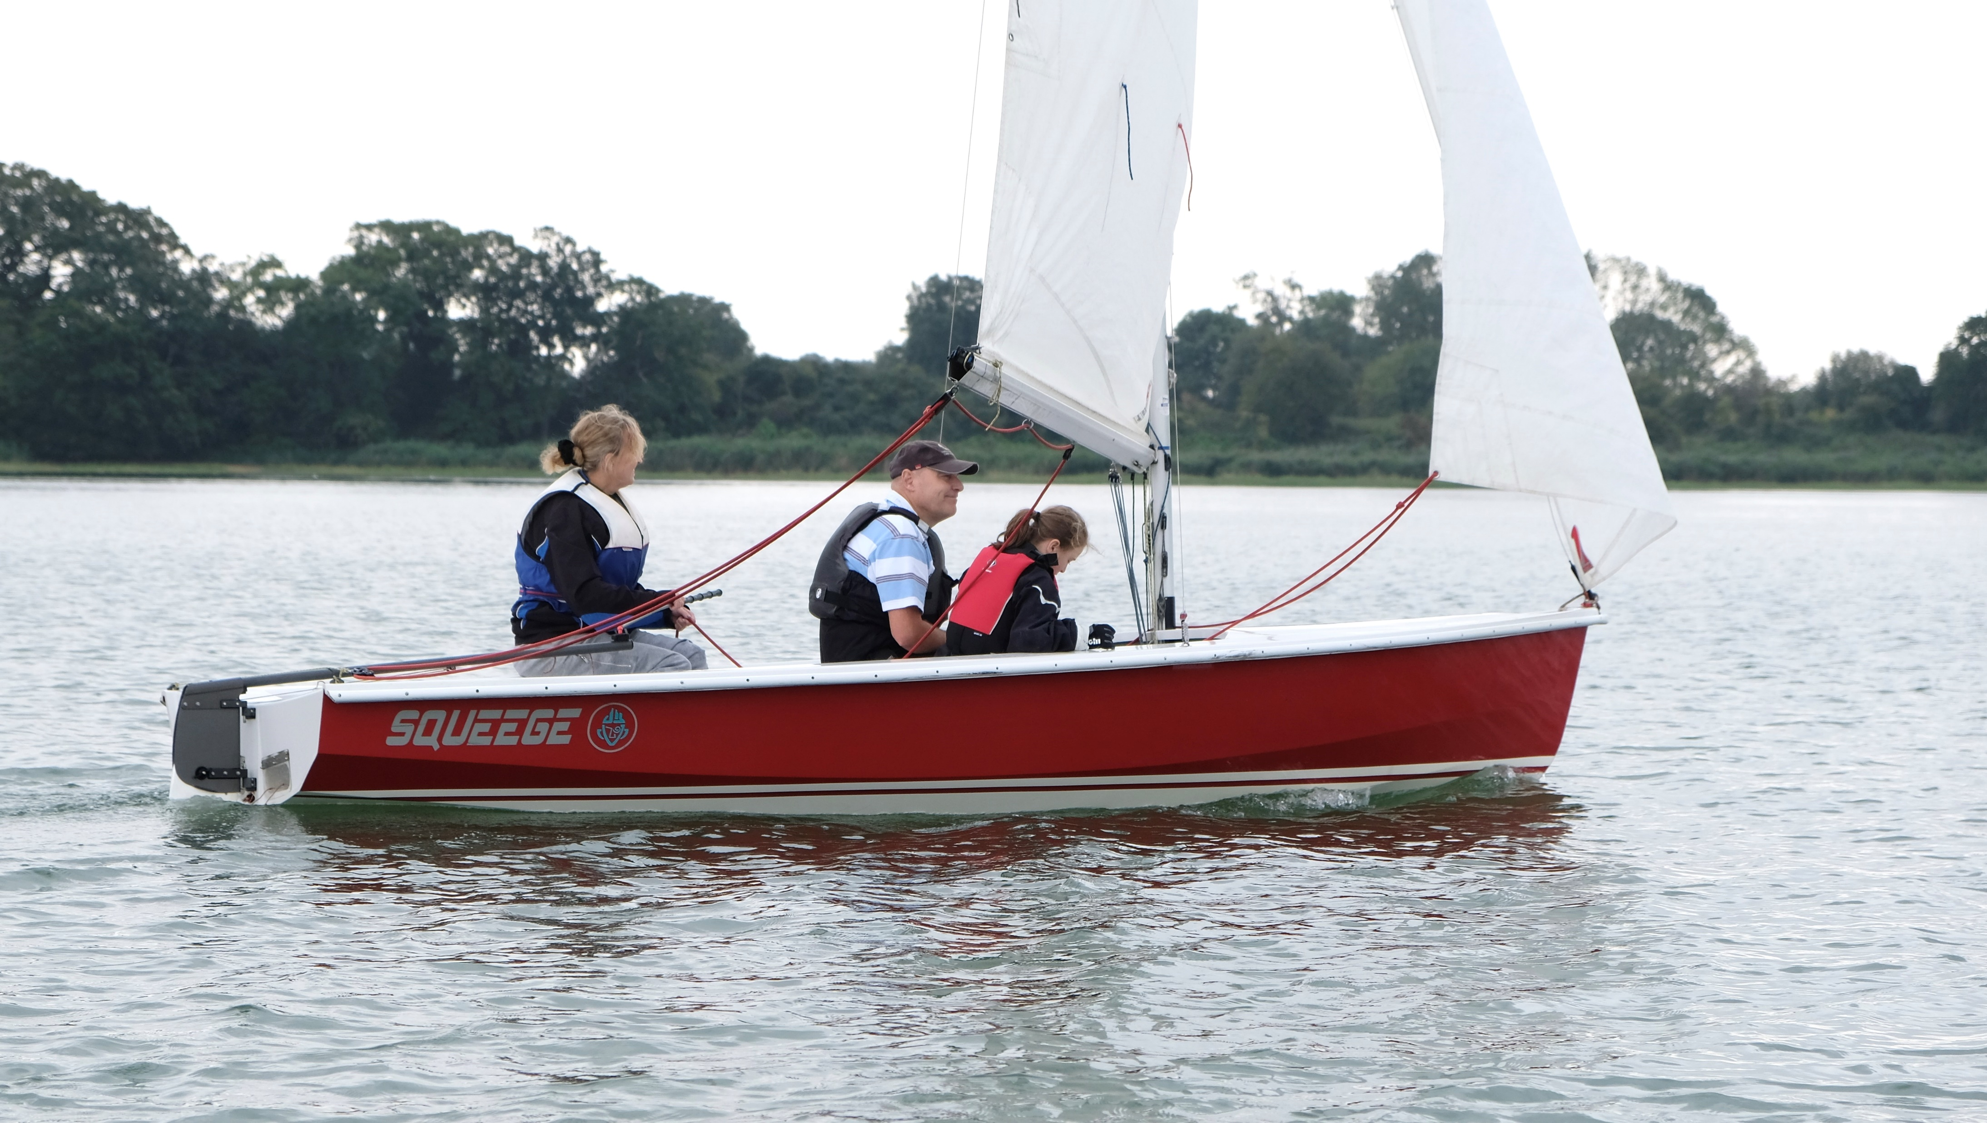
Other boating activities
Includes:
Safety boats
Cruising in dinghies
Sailing yachts

Slide 5
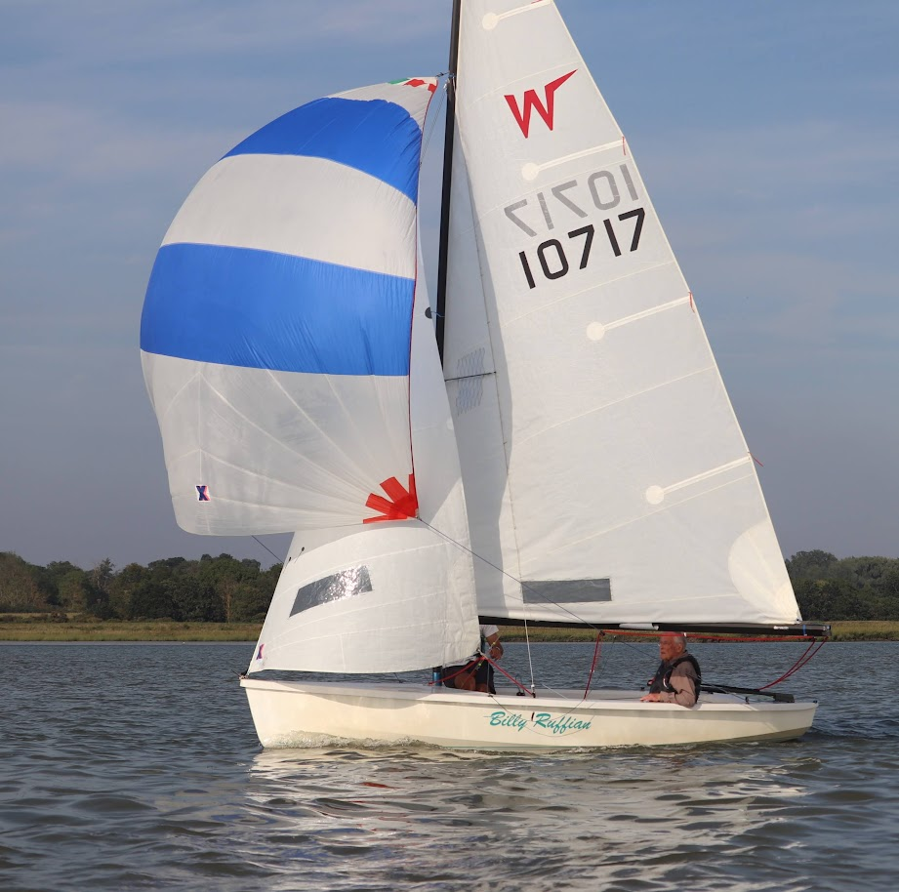
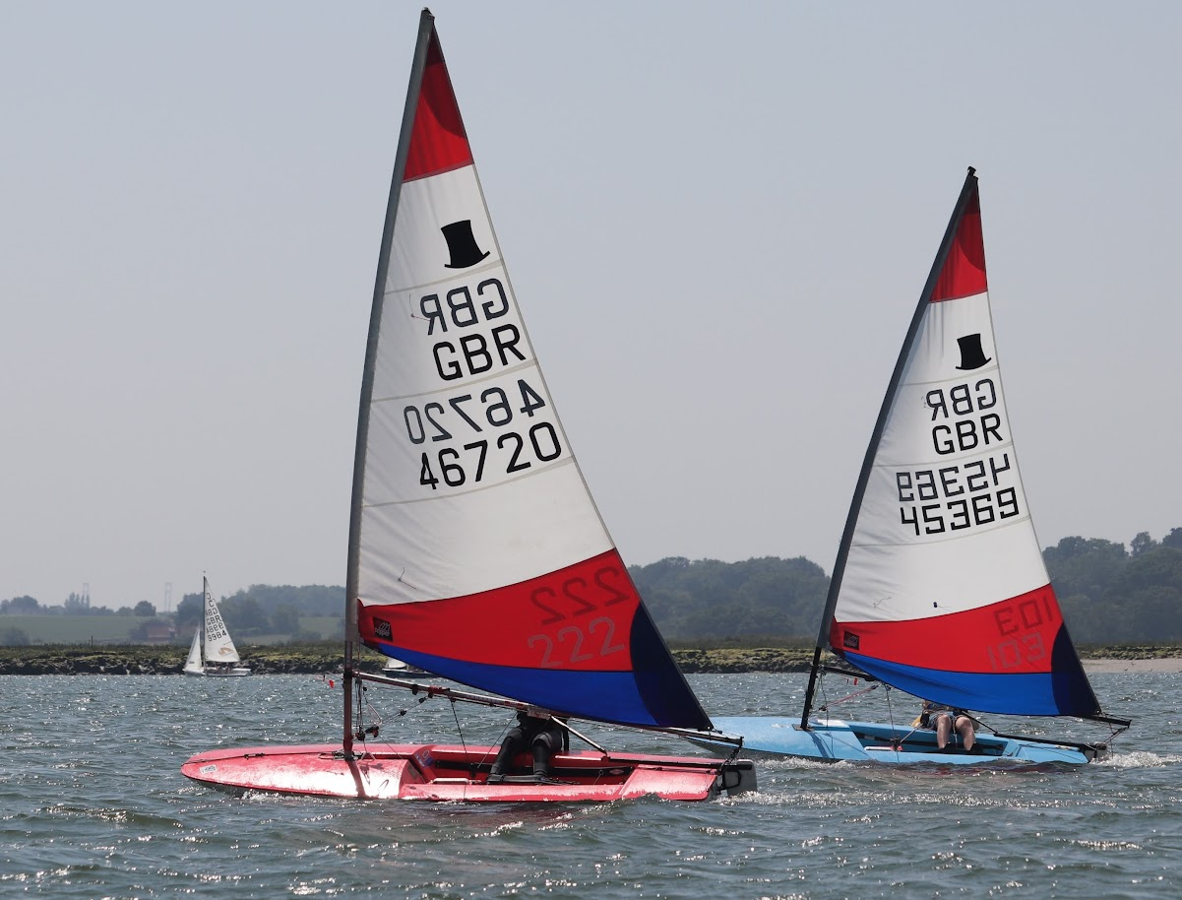
For all ages
Oldest racing sailor – he still wins at 90!
Junior fleets

Slide 6
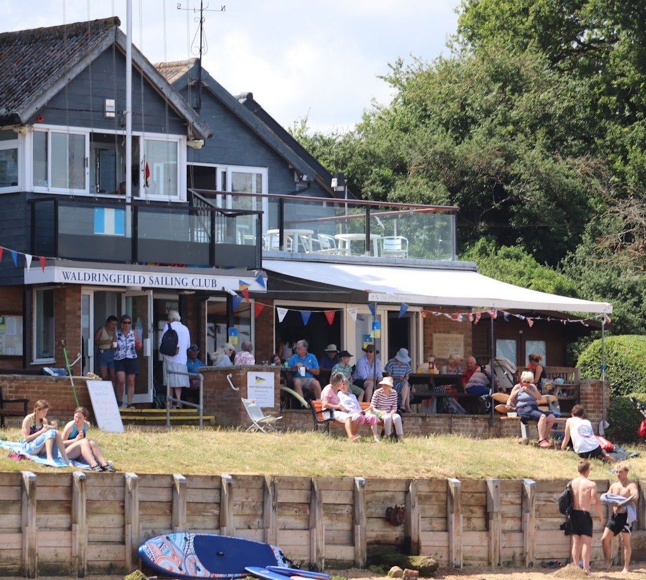
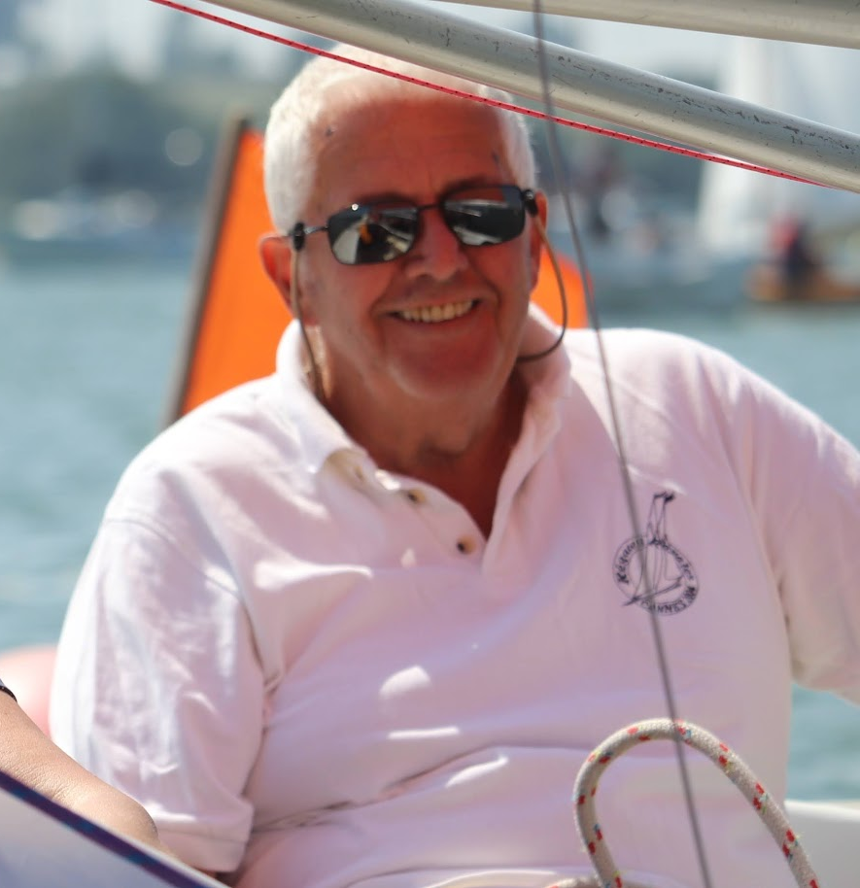
Members make things happen!
Without our members volunteering to do ‘duties’, we could not:
Run races
Teach and learn
Provide food and drink
Have parties and talks
Run the organisation

Slide 7
A Century of Sailing: Waldringfield Sailing Club 1921-2021
History, information and characters
Available via www.waldringfieldsc.com and from the club, £35

Slide 8
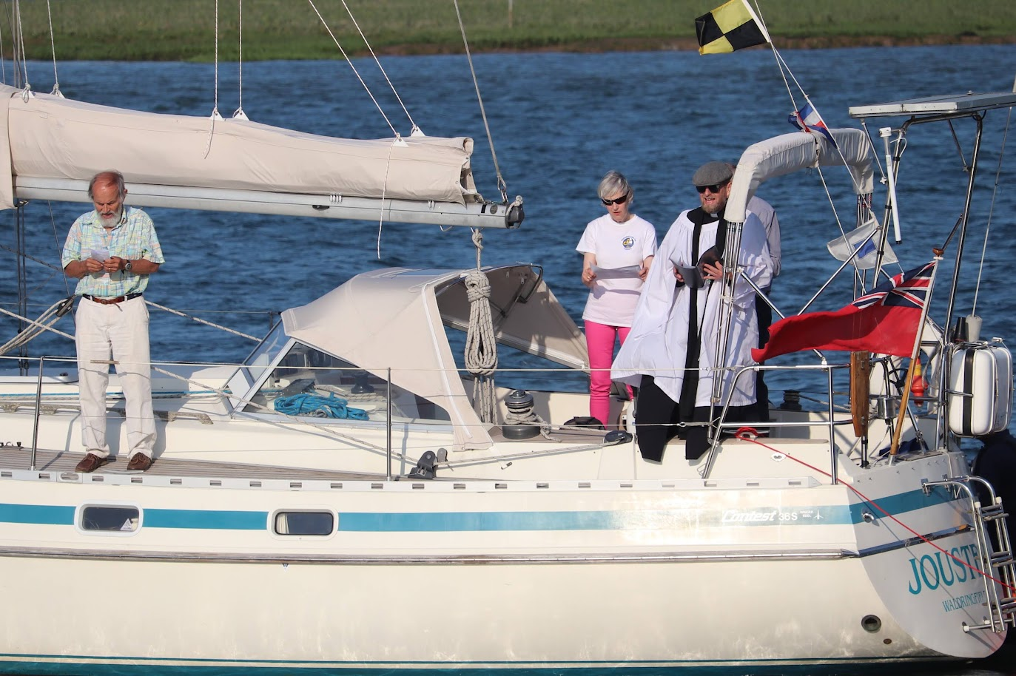
Come and join us
Non-members welcome to the Regatta Shore Events – for children of all ages – and Yachtsman’s Service (13, 14 July 2024)
To sail, of course! Whether to try out, as adult or junior, or join the racing
To support racing - in safety boats, in the galley, and in other ways
To make friends

